Slide 1
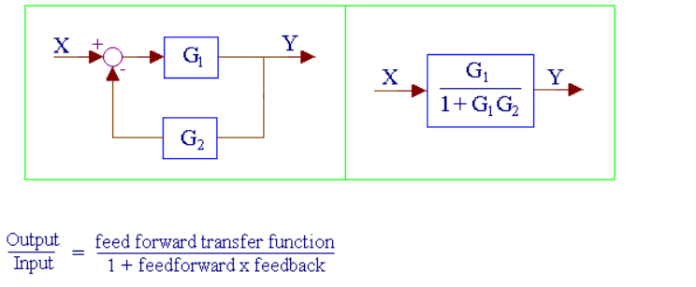
DEVELOP A VEHICLE DYNAMICS MODEL: MODEL REDUCTION
http://www.msubbu.in/sp/ctrl/BD-Rules.htm

Slide 2



DEVELOP A VEHICLE DYNAMICS MODEL: MODEL REDUCTION
$K_{p}+\frac{K_{i}}{s}+K_{d}s=\frac{K_{d}s^{2}+K_{p}s+K_{i}}{s}$
$$V\left(s\right)/U(s)=1/\left(mS+b\right)$$
$\frac{K_{d}s^{2}+K_{p}s+K_{i}}{\left(m+K_{d}\right)s^{2}+\left(b+K_{p}\right)s+K_{i}}$

Slide 3
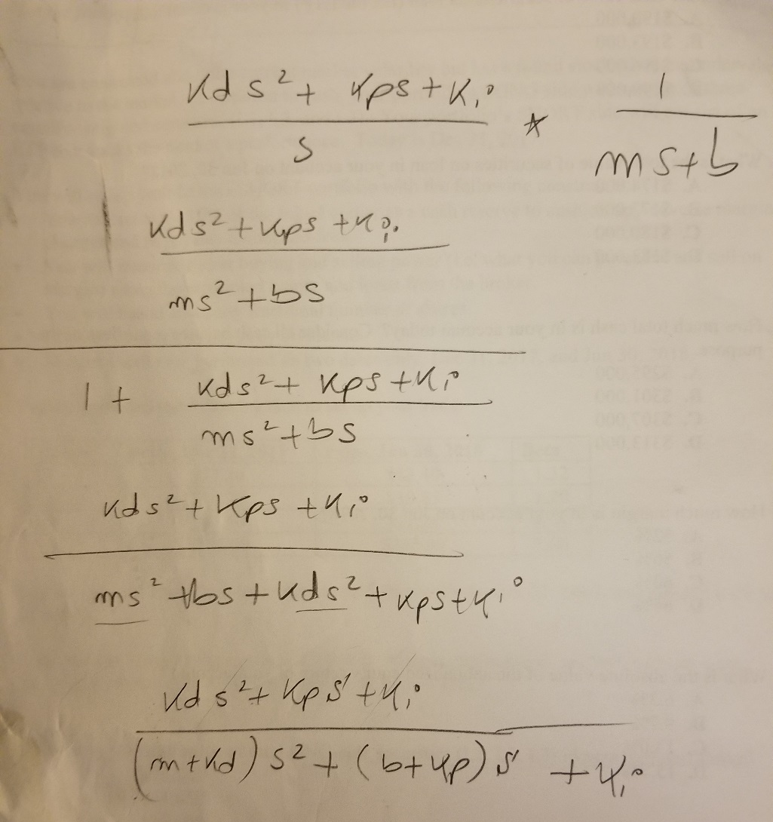

DEVELOP A VEHICLE DYNAMICS MODEL: MODEL REDUCTION
$\frac{K_{d}s^{2}+K_{p}s+K_{i}}{\left(m+K_{d}\right)s^{2}+\left(b+K_{p}\right)s+K_{i}}$

Slide 4


DEVELOP A VEHICLE DYNAMICS MODEL: ASSUME P- CONTROLER ONLY
$\frac{K_{d}s^{2}+K_{p}s+K_{i}}{\left(m+K_{d}\right)s^{2}+\left(b+K_{p}\right)s+K_{i}}$
$\frac{K_{p}s}{\left(m\right)s^{2}+\left(b+K_{p}\right)s}$

